Slide 1


Slide 3

IPL TOURNAMENT QUICK STATUS
IPL TOURNAMENT QUICK STATUS

Slide 4
IPL TOURNAMENT QUICK STATUS
IPL TOURNAMENT QUICK STATUS
IPL 2025 Quick Stats
Total Teams: 10
Total Matches: 74
Total Days: Approx. 60 days (2 months season)
Venues/Stadiums: Around 12 major stadiums across India
Match Format: T20
Schedule: March 2025 – May 2025
Players Analyzed: ~200+ players

Slide 5

Problem Statement:
IPL data is large and complex, with frequent updates and many details to track.
Solution:
Built an interactive Power BI dashboard with dynamic visuals, filters, and relationships to simplify IPL data analysis.
What I Did:
Collected, cleaned, and modeled IPL data; created measures with DAX; designed clear visuals for teams, players, matches, and points tables.

Slide 6

1 .Idea
Theme and about data
2. Research
Over view of the Dashboard
4.Execution Squads in the dashboard
3.Analysis
Points table in the dashboard

Slide 7

1 .Idea
Theme and about IPL
An exciting T20 cricket league showcasing 10 teams competing over 2 months across India, bringing together top international and domestic players in a high-energy, fan-driven tournament.

Slide 8
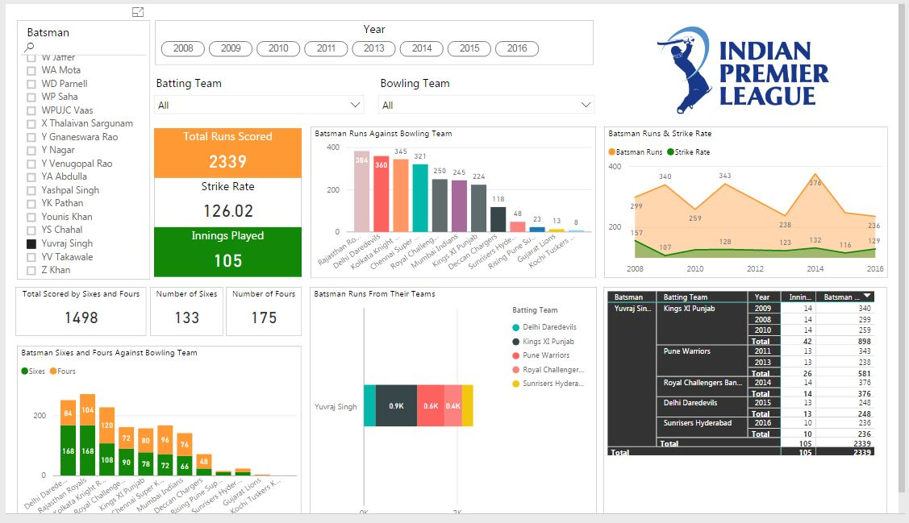
1. A high-energy T20 league with 10 teams, 2 months, top players, across India.
2. Research
Over view of the Dashboard
An interactive dashboard to explore IPL 2025 teams, players, match schedules, and points tables, with clear visuals and easy navigation for quick insights.

Slide 9

1. A high-energy T20 league with 10 teams, 2 months, top players, across India.
3.Analysis
Points table in the dashboard
2. Interactive dashboard showing IPL teams, players, matches, schedules, and points in a clear, user-friendly view.
This dashboard includes a dynamic points table, team and player details, full match schedules, venues, and match results - providing a complete, interactive view of the IPL 2025 season.

Slide 10

1. A high-energy T20 league with 10 teams, 2 months, top players, across India.
4.Execution Squads in the dashboard
2. Interactive dashboard showing IPL teams, players, matches, schedules, and points in a clear, user-friendly view.
Over all dashboard view with different features and new methods
3. Dashboard shows points, teams, players, schedules, venues, and results.

Slide 11
1 .Idea
Theme and about IPL
2. Research
Over view of the Dashboard
3.Analysis
Points table in the dashboard
4.Execution Squads in the dashboard

Slide 12
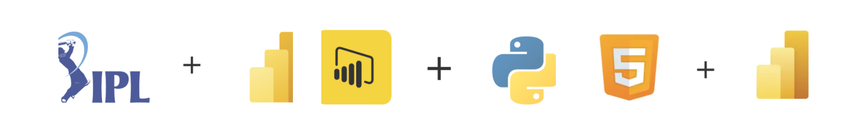
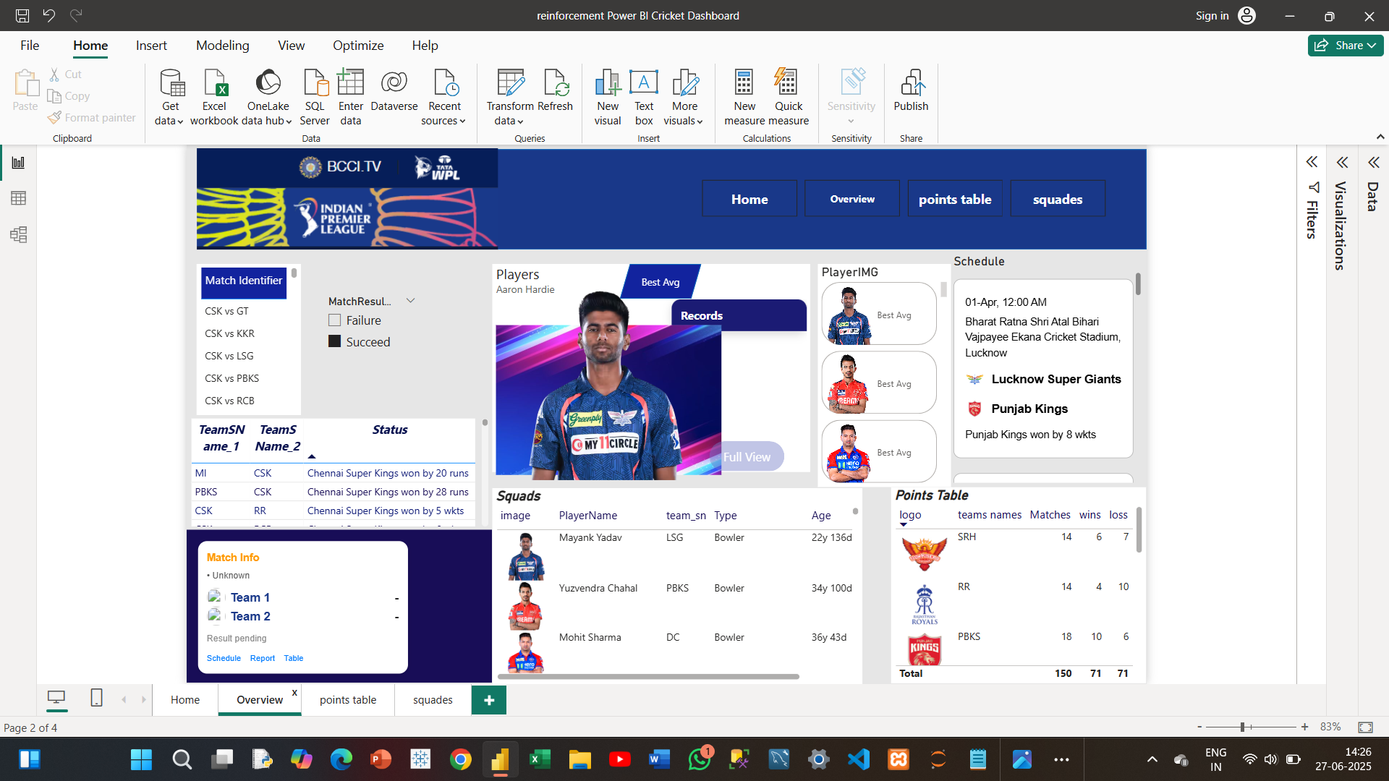
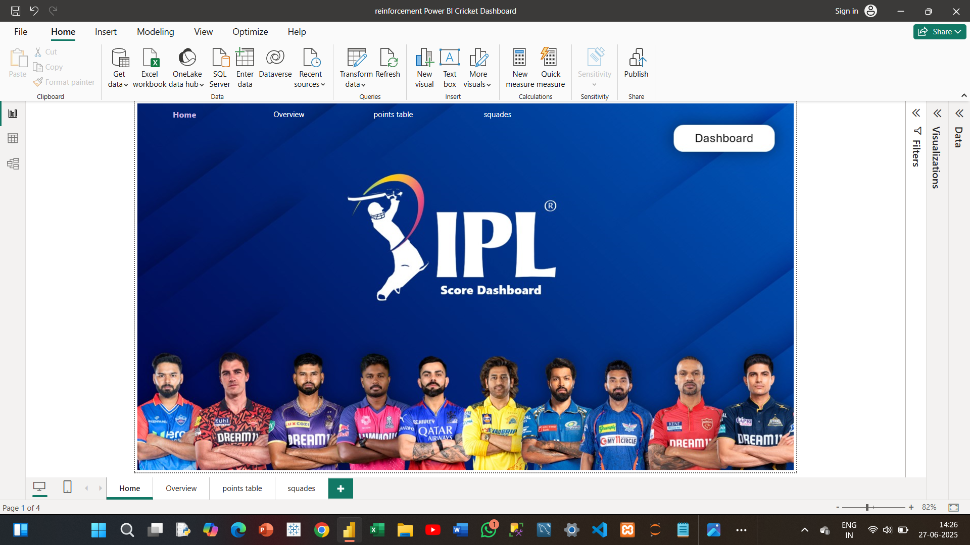
In the dashboard with the creation of dynamic visuals, slicers, drill-through, and cross-filtering in Power BI, this dashboard delivers interactive insights from large IPL datasets, making data exploration fast and intuitive.

Slide 13


